Slide 1

System of Negation in Geshiza
Sami Honkasalo
University of Helsinki
samihonkasalo@gmail.com
Syntax of the World’s Languages 8: WS2 (Negation)
Sep 3-5 2018, Paris

Slide 2
Geshiza and its speakers
Autoglossonyms: bæ-skæ ‘Tibetan language’; roŋ-skæ ‘farmer language > local language’; ŋæ=ɲi skæ ‘our language’; rgævɕetsa-skæ ‘Geshiza language’
Distribution: spoken in Geshiza Valley of Danba County of Sichuan Province, China
Genealogical affiliation: Trans-Himalayan (Tibeto-Burman), Qiangic (?), rGyalrongic, Horpa-Khroskyabs, Horpa
Central Horpa lect (Sun forthcoming)

Slide 3
At least two major dialects: Eastern and Western Geshiza
Present study based on Eastern Geshiza
Approx. 8000 speakers in total, of which 5000 for Eastern Geshiza
Speakers ethnic Tibetans, but under heavy influence from Chinese: bilingualism prevalent
Measured with UNESCO’s (2003) language vitality model, the Geshiza is becoming endangered, a recent development
Inadequately described, Duo’erji (1998), a Chinese grammatical sketch as the only reference resource with limited reliability

Slide 4
Typological profile
Large phoneme inventories: 37 full and 3 marginal consonants, 8 monophthong vowels, non-tonal
Ergative language in morphosyntactic alignment
APV, SV
Morphologically complex in the verbal system
Predominantly, but not fully prefixing
Mostly exhibits dependent marking, which differentiates it from core rGyalrong languages featuring a tendency for head-marking (see Sun 2014: 631).

Slide 5
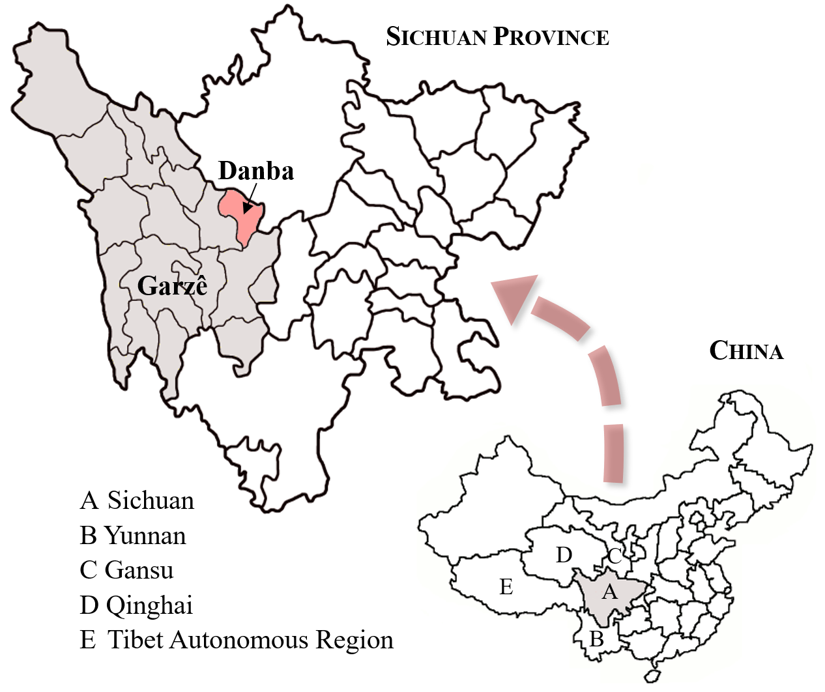
Figure 1. Geshiza homeland
The map is based on a Wikipedia Creative Commons map by Croquant (2007) with modifications in text, colors, and the arrow symbol used (source: https://en.wikipedia.org/wiki/Danba_County#/media/File:Location_ of_ Danba_within_Sichuan_(China).png; license: https://creativecommons.org/licenses/by/3.0/).

Slide 6
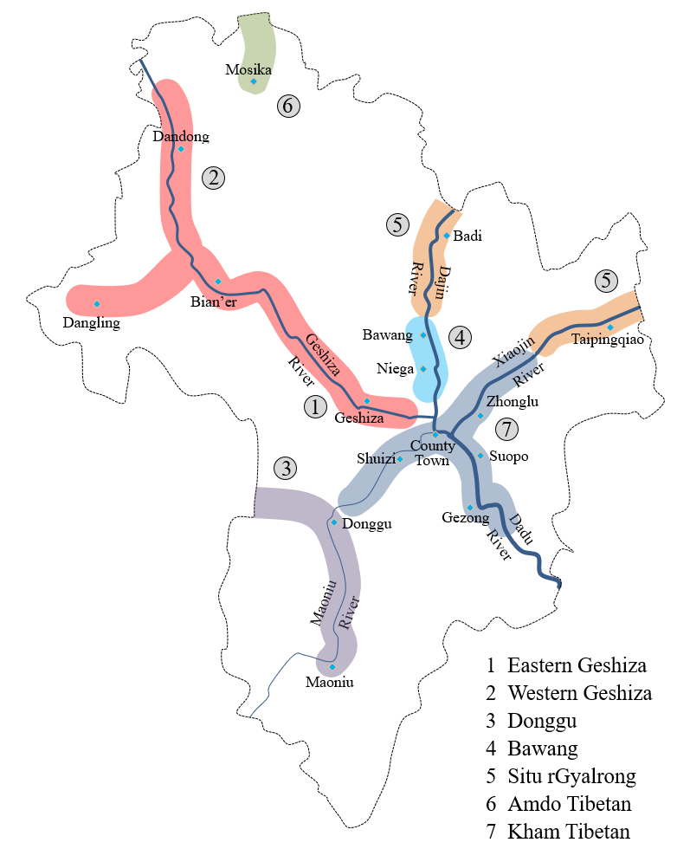
Figure 2. Geshiza among the languages of Danba County

Slide 7
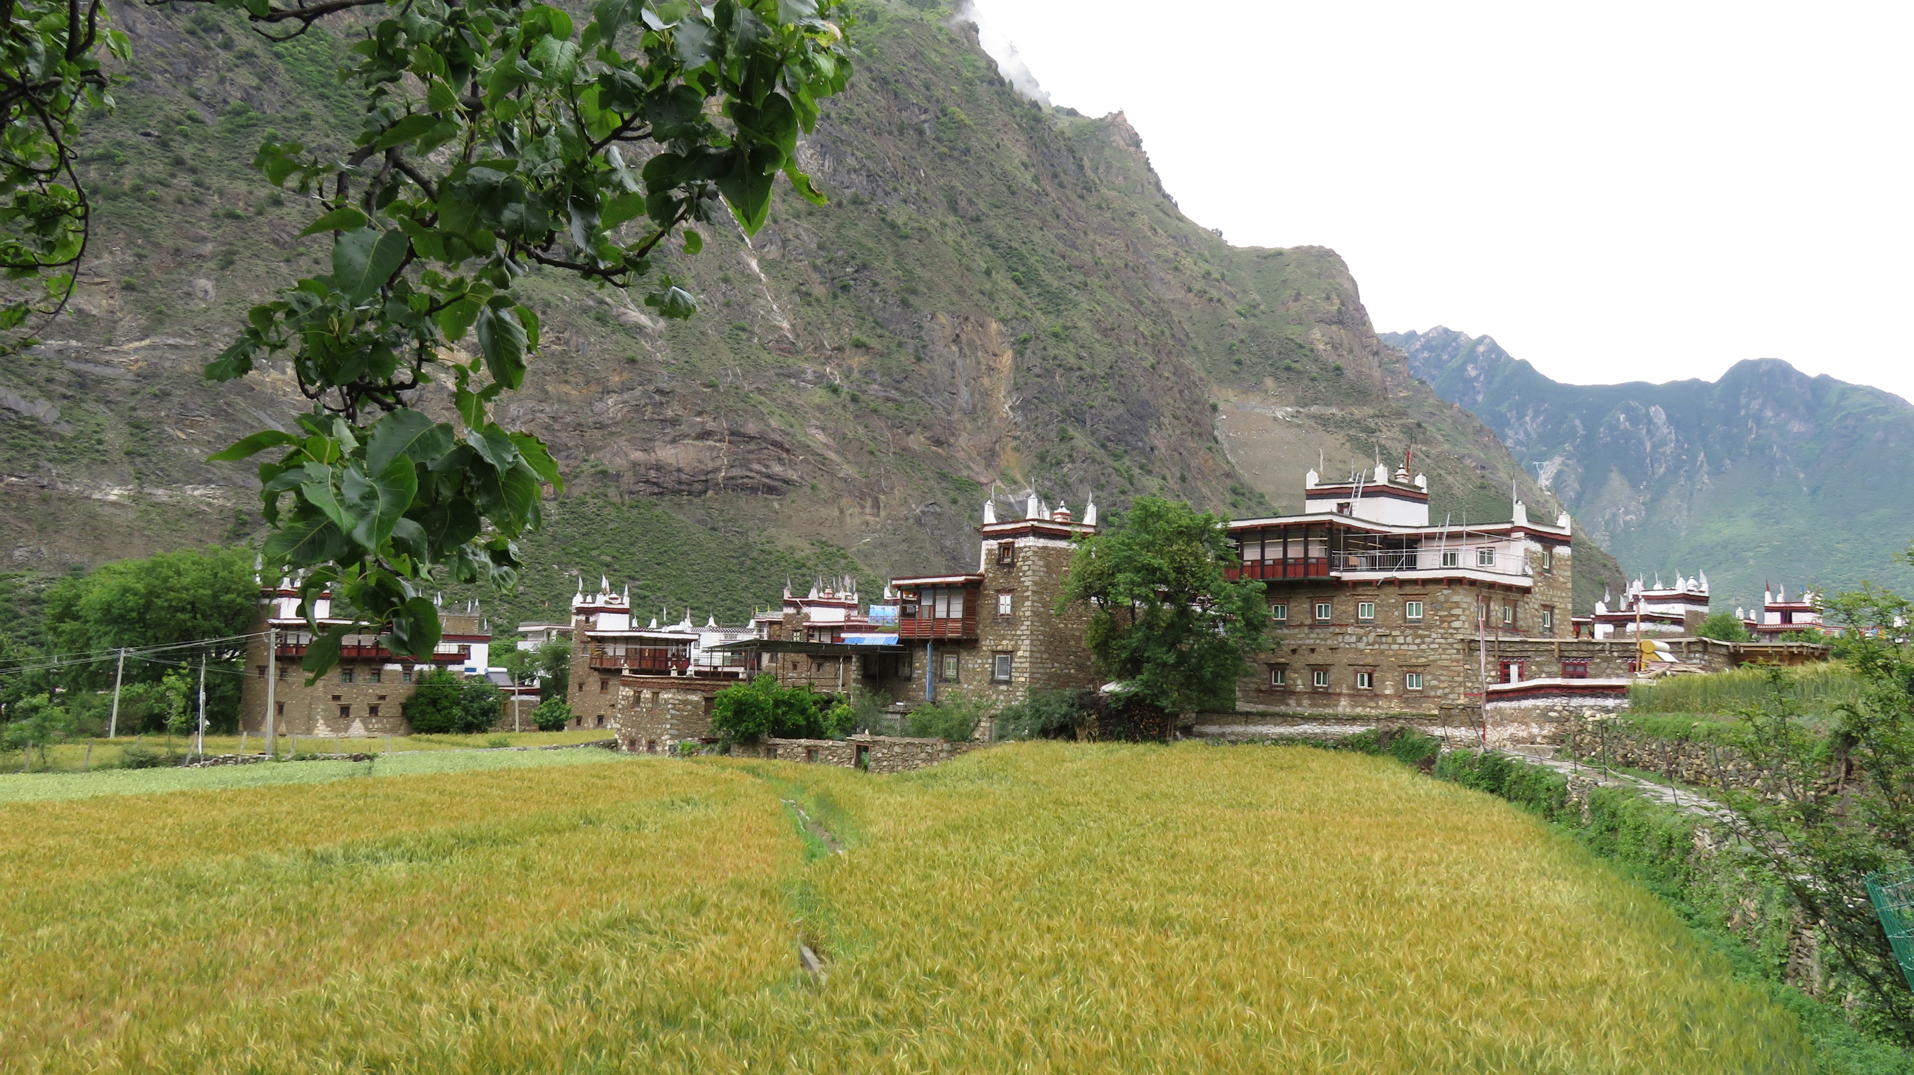
Figure 3. Balang Village, primary fieldwork location (spring 2017)

Slide 8
System of negation

Slide 9
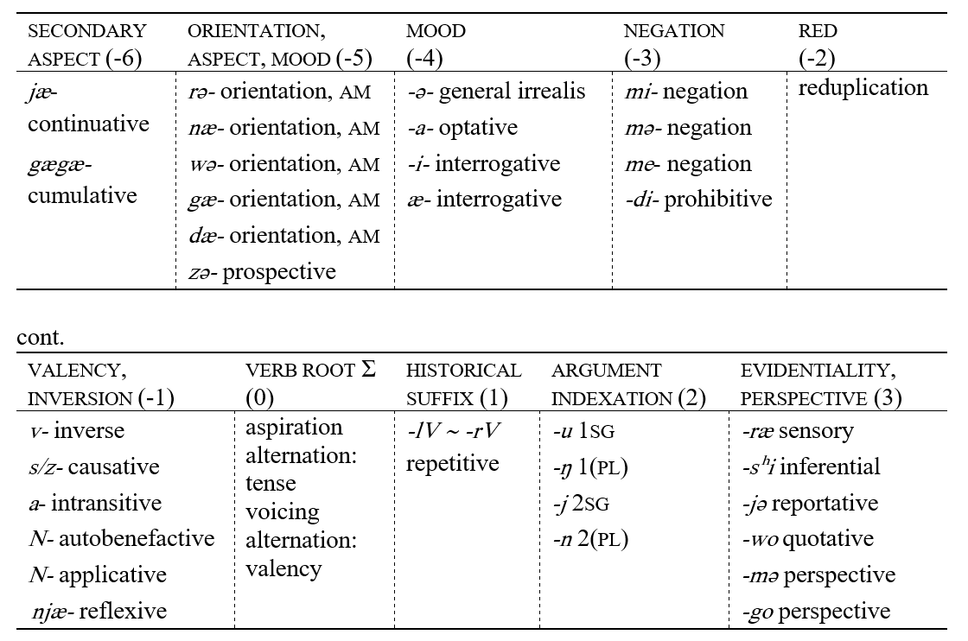
Table 1. Verbal template of Geshiza
Standard negation in Geshiza is generally symmetric
For instance, see negation in the imperfective aspect (a, b):

Slide 10
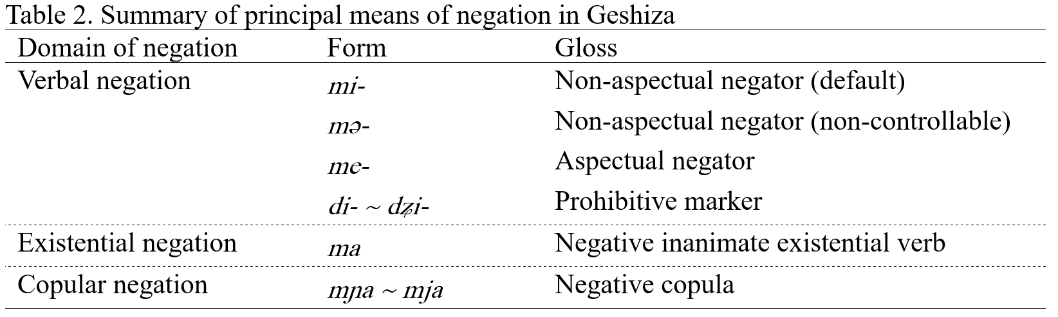
Overview
Miestamo (2016) as the basis
All negation morphology found in the domain of verbs
Summary of the negative forms in table 2
Difference between mi-, mə-, and me- discussed further below

Slide 11
Etymological note
All negators appear to have deep roots in linguistic history and can be traced back to the proto-language
“m-series” negators: reflect Proto-Trans-Himalayan *ma- (see LaPolla 2003: 27)
Copula mɲa: possibly from the coalescence of a “m-series” negator and the affirmative copula ŋuə: *mV-ŋuə > mɲa, but further evidence necessary, vocalization also problematic
Prohibitive: from Proto-Trans-Himalayan *ta-⪤ *da (see Matisoff 2003: 586).

Slide 12
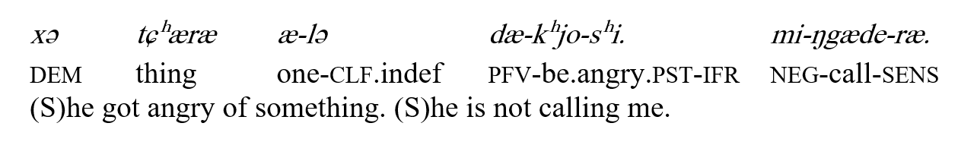
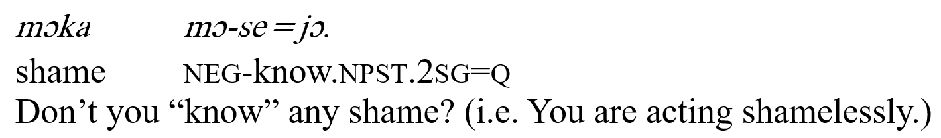
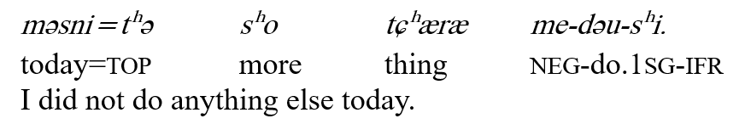
Standard negation
Payne (1985); Miestamo (2005)
Paradigmatic mutually exclusive prefixes in slot -3 (see table 1): mi-, mə-, me-
(a)
(b)
(c)

Slide 13
Key questions: 1. condition for the distribution of mi- and me- and 2. that of mi- and mə-
Linking of negation and aspect in Geshiza differs from similar documented phenomena in rGyalrongic languagges
For instance, difference between two negative prefixes is interpreted in terms of an aspectual contrast in Jiaomuzu rGyalrong: imperfective vs. perfective (e.g. Prins 2016)

Slide 14
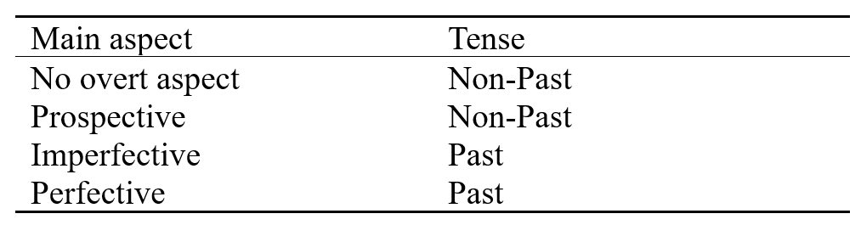
Table 3. Aspect and tense in Geshiza
In addition to the lack of formal aspect marking, Geshiza has three main formally marked aspects: prospective (zə-), imperfective (gæ-), and perfective (dæ-), all marked with verbal prefixes (see also table 1.)
The language also has a binary tense system (Comrie 1985: 48-49) with past and non-past expressed through aspiration alternation
Aspect and tense strongly interlinked in the language:

Slide 15
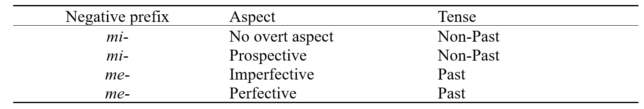
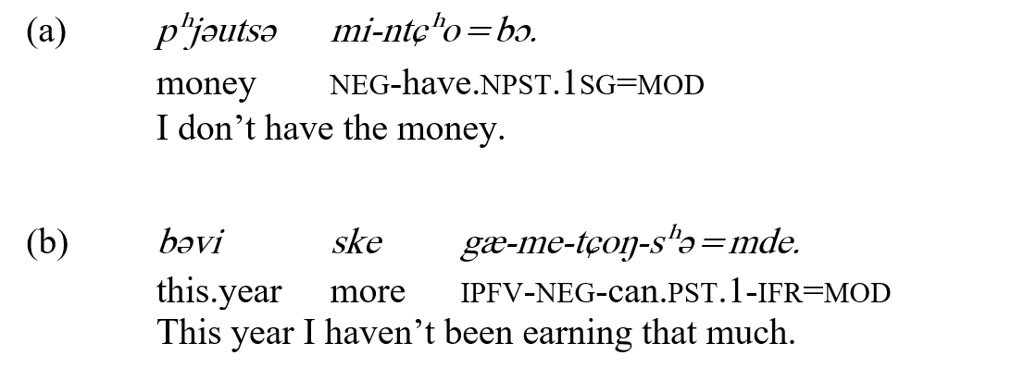
Table 4. Hypothesis for the distribution of mi- and me-
At first sight, it looks that the distribution of the negators mi- and me- can be explained by means of tense:
mi- for the non-past (a) and me- for the past (b):

Slide 16
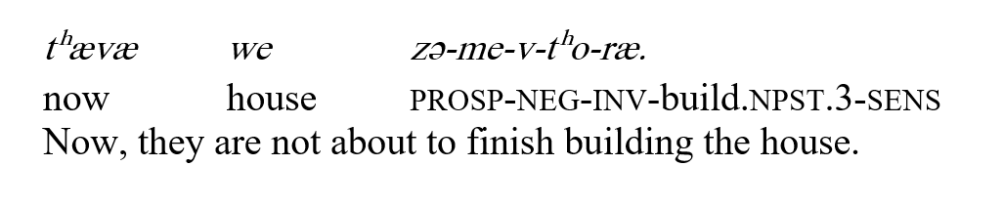
The explanation is erroneous
With the prospective aspect that is marked with zə- and requires the non-past tense, the negator me- occurs:
The pattern is relatively rare in discourse, yet it occurs > need to reconsider the conditions for the use of mi- and me-
Alternative explanation for the distribution:
mi- is used in aspectually neutral forms while me- is used with aspectual marking

Slide 17
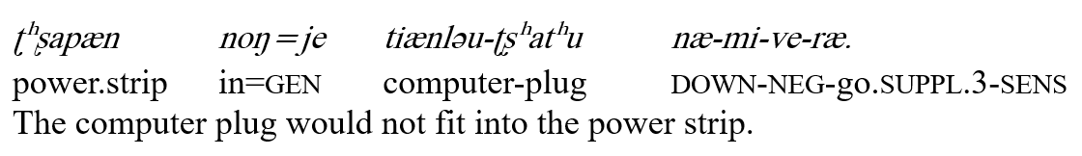
It should be noted that the presence of an orientational prefix cannot be established as a condition for the distribution of me-
In the following example with no overt aspectual marking, me- would be erroneous, despite the presence of a verbal prefix:

Slide 18
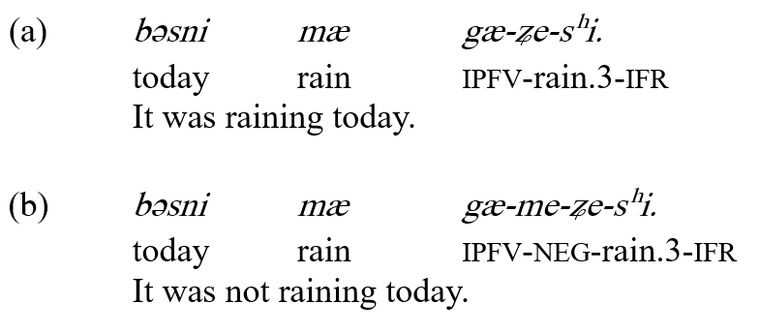
Asymmetries
Standard negation in Geshiza is generally symmetric
For instance, see negation in the imperfective aspect (a, b):

Slide 19
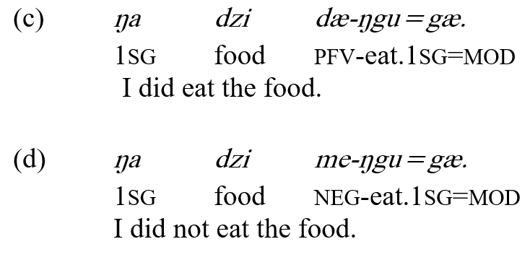
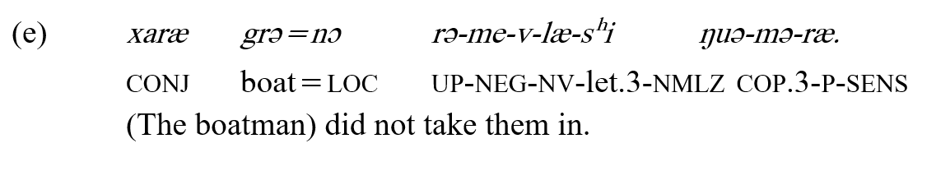
The perfective aspect, however, exhibits asymmetry, since the negative me- and neutral perfective prefix dæ- are mutually incompatible (c, d):
Prefixes that indicate perfectivity and direction (concrete or conventionalized abstract) at the same time have no such limitations (e):

Slide 20
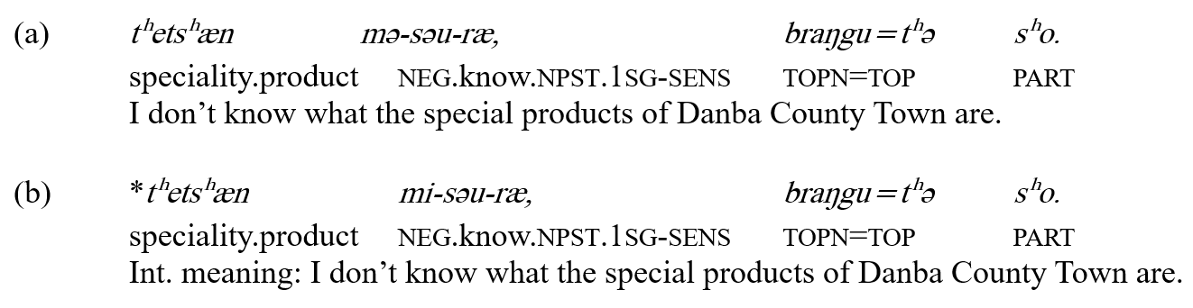
The negator mi- fails to surface on occasion in its expected context where the negator mə- appears instead (a, b)
Phenomenon attested in 16 verbs (table in the following slide), but possibly more wide-spread
appearance of mə- cannot be interpreted as an automatic phonological process
How to explain this behavior?

Slide 21
Table 5. Verbs negated with mə-: overview
Verb | Negation | Gloss
dzo | mə-dzo | to fit into
n/a | mə-grə | to not be able
mnæ | mə-mnæ | to (be able) to reach
mɲə | mə-mɲə | to be able
ŋi | mə-ŋi | to be all right, acceptable
v-ri | mə-v-ri | to find
v-se | mə-v-se | to know
n/a | mə-ske | should not
sko | mə-sko | to be able
snə | mə-snə | to dare
ntʰje | mə-ntʰje | to hear
stʰæ | mə-stʰæ | to finish
tɕɔ | mə-tɕɔ | to be, feel comfortable
tɕʰa | mə-tɕʰa | to be able
vɕe | mə-ɕe | to need, have to
vdo | mə-vdo | to see

Slide 22
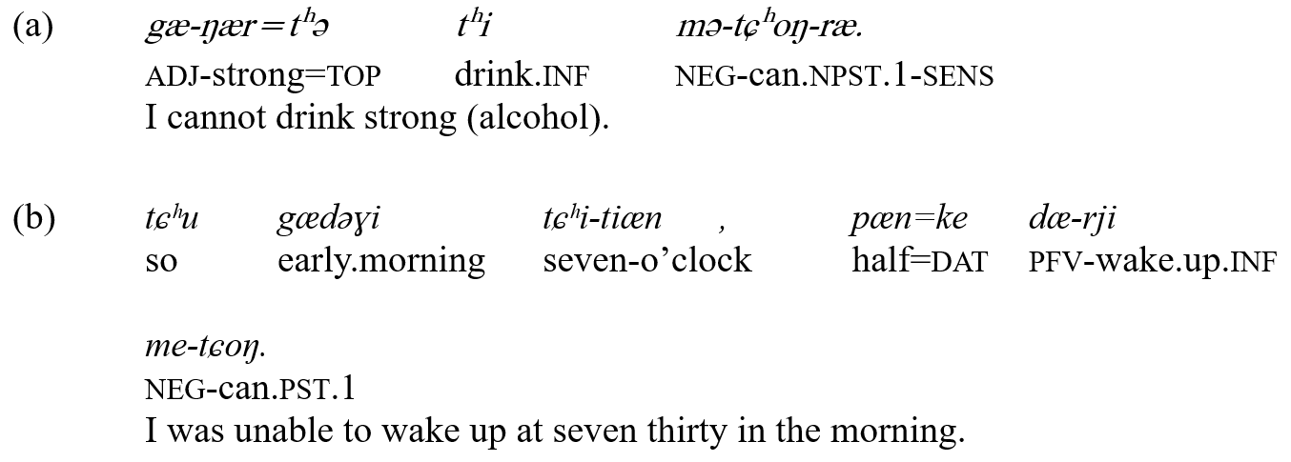
mə- only surfaces as a substitute of mi- (a); in aspectual negation me- must be used, similar to all other verbs (b, perfective aspect):

Slide 23
Distribution of mə- of is not random:
1. Modal verbs
Modal verbs form the first subset of verbs that require the negator mə-, being ungrammatical with the negator mi-
Geshiza has eight modal verbs that form a class both due to their semantic and syntactic properties
For instance, Geshiza infinitives function as complements with modal verbs (a, b, c)

Slide 24
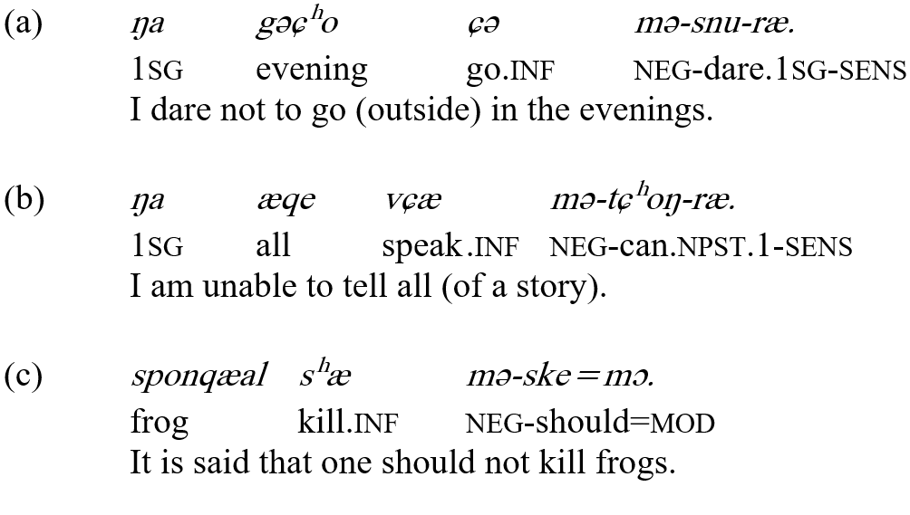

Slide 25
Table 6. Verbs negated with mə-
Verb | Negation | Gloss
dzo | mə-dzo | to fit into
n/a | mə-grə | to not be able
mnæ | mə-mnæ | to (be able) to reach
mɲə | mə-mɲə | to be able
ŋi | mə-ŋi | to be all right, acceptable
v-ri | mə-v-ri | to find
v-se | mə-v-se | to know
n/a | mə-ske | should not
sko | mə-sko | to be able
snə | mə-snə | to dare
ntʰje | mə-ntʰje | to hear
stʰæ | mə-stʰæ | to finish
tɕɔ | mə-tɕɔ | to be, feel comfortable
tɕʰa | mə-tɕʰa | to be able
vɕe | mə-ɕe | to need, have to
vdo | mə-vdo | to see

Slide 26
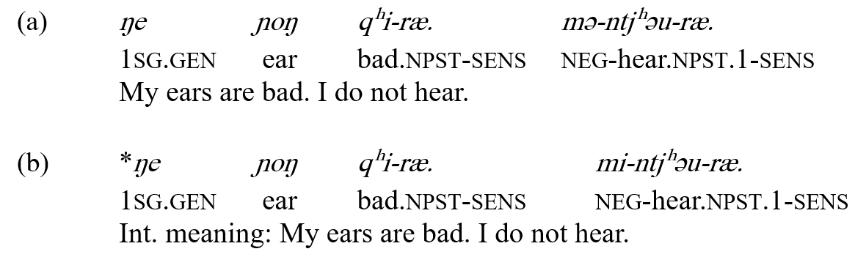
2. Perception verbs
Terminology following Wächli (2016)
‘Opportunistic’ perception verbs (non-controlled experience) ntʰje ‘to hear’ and vdo ‘to see’ must be negated with mə- (a, b)
‘Explorative’ perception verbs (controlled activity) sŋi ‘to listen’ and stɕʰəkʰi/mtɕʰəkʰi ‘to watch’ take mi-

Slide 27
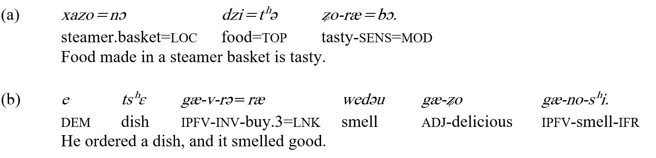
Phenomenon not attested in the other opportunistic perception verbs, since they are incompatible with human subjects carrying out the perception
Negation: mi-ʑo-ræ (a); gæ-me-no-sʰi (b):

Slide 28
Table 7. Verbs negated with mə-
Verb | Negation | Gloss
dzo | mə-dzo | to fit into
n/a | mə-grə | to not be able
mnæ | mə-mnæ | to (be able) to reach
mɲə | mə-mɲə | to be able
ŋi | mə-ŋi | to be all right, acceptable
v-ri | mə-v-ri | to find
v-se | mə-v-se | to know
n/a | mə-ske | should not
sko | mə-sko | to be able
snə | mə-snə | to dare
ntʰje | mə-ntʰje | to hear
stʰæ | mə-stʰæ | to finish
tɕɔ | mə-tɕɔ | to be, feel comfortable
tɕʰa | mə-tɕʰa | to be able
vɕe | mə-ɕe | to need, have to
vdo | mə-vdo | to see

Slide 29
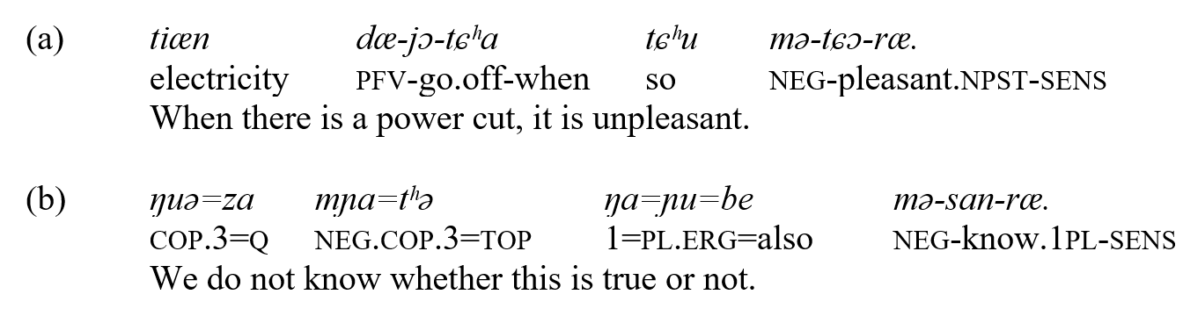
3. Other verbs of low controllability
Controllability encoded in grammars of greater Tibetosphere’s languages, e.g. Wutun (Sandman 2016)
Explaining the remaining verbs negated with mə-, it is clear that the subject has low controllability in each case (a, b)
The verb stʰæ ‘to finish’ that looks exceptional follows the illustrated pattern: must be made causative stʰæ-pʰə to emphasize the subjects control over the finishing process

Slide 30
Table 8. Verbs negated with mə-
Verb | Negation | Gloss
dzo | mə-dzo | to fit into
n/a | mə-grə | to not be able
mnæ | mə-mnæ | to (be able) to reach
mɲə | mə-mɲə | to be able
ŋi | mə-ŋi | to be all right, acceptable
v-ri | mə-v-ri | to find
v-se | mə-v-se | to know
n/a | mə-ske | should not
sko | mə-sko | to be able
snə | mə-snə | to dare
ntʰje | mə-ntʰje | to hear
stʰæ | mə-stʰæ | to finish
tɕɔ | mə-tɕɔ | to be, feel comfortable
tɕʰa | mə-tɕʰa | to be able
vɕe | mə-ɕe | to need, have to
vdo | mə-vdo | to see

Slide 31
Conclusion: the negator mə- substitutes for mi- to negate a subset of non-controllable verbs
All of the discussed verbs are common in everyday discourse
Howerver, not all verbs that can be interpreted as non-controllable take mə-; for instance, spa ‘to feel thirsty’ (causativization has no effect here):
While more historical-comparative data is needed, the 16 verbs may be a vestige of a historical pattern that has been levelled through analogy in most cases

Slide 32
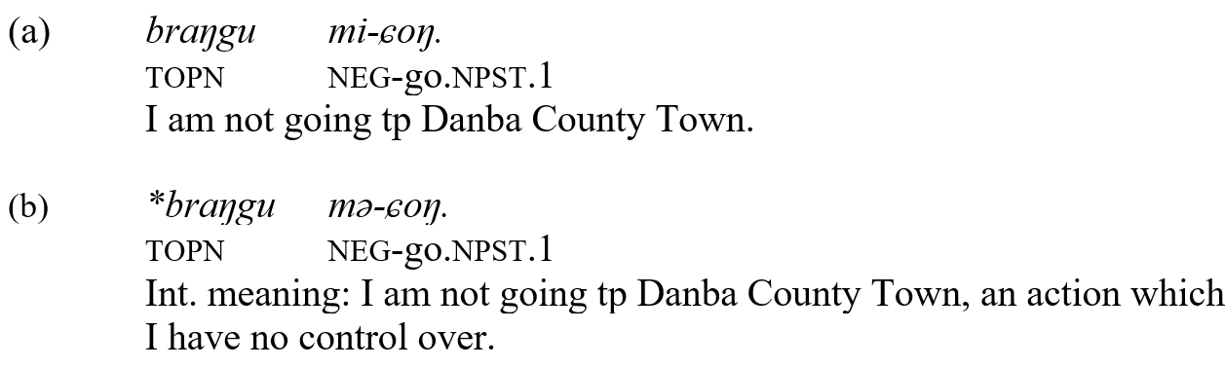
Ultimately, distribution of mi- and mə- is fixed on a lexical basis and the choice of the negator plays no role in disambiguating potentially non-controllable verbs:

Slide 33
Abbreviations
1 first person
2 second person
3 third person
am aspect-mood
abs absolutive
adj adjective
caus causative
clf classifier
com comitative
cop copula
dat dative
dem demostative
dir orientational prefix
down downward orientation
du dual
erg ergative
gen genitive
ifr inferential
inf infinitive
imp imperative
inv inverse
ipfv imperfective
lnk linker
loc locative
mod modal enclitic
nmlz nominalizer
npst non-past
p perspective
part (discourse) particle
pfv perfective
pl plural
proh prohibitive
prosp prospective
pst past
red reduplication
q question
sens sensory evidential
sg singular
suppl suppletive
top topic
topn toponym
~ reduplication
- morpheme boundary
= clitic boundary
Due to variation in font design, a and a; æ and æ represent allographs and are not used as separate graphemes here.

Slide 34
References
Duo’erji. 1998. 道孚语格什扎话研究 [A Study of Geshiza Variety of the Daofu Language]. Beijing: Zhongguo Zangxue Chubanshe.
Matisoff, James A. 2003. Handbook of Proto-Tibeto-Burman: System and Philosophy of Sino-Tibetan Reconstruction. Berkeley, Los Angeles and London: University of California Press.
Miestamo, Matti. 2005. Standard Negation: The Negation of Declarative Verbal Main Clauses in Typological Perspective. Berlin and New York: Mouton de Gruyter.
—— 2016. Questionnaire for describing the negation system of a language.
Payne, John R. 1985. Negation. In Shope, Timothy (ed.) Language Typology and Syntactic Description, Vol I: Clause Structure. Cambridge: Cambridge University Press., pp. 197-242.
Sun, Jackson T.-S. 2014. Delineating derivation and inflection. In Štekauer, Pavol; Lieber, Rochelle. The Oxford Handbook of Derivational Morphology. Oxford: Oxford University Press, pp. 630-650.
—— forthcoming. The Ancestry of Horpa: Further Morphological Evidence.
LaPolla, Randy. 2003. Overview of Sino-Tibetan morphosyntax. In Thurgood, Graham; LaPolla, Randy J. (eds.) 2003. Sino-Tibetan Languages. London and New York: Routledge, pp 22-41.
UNESCO Ad Hoc Expert Group on Endangered Languages. 2003. Language Vitality and Endangerment. Document submitted to the International Expert Meeting on UNESCO Programme Safeguarding of Endangered Languages, Paris, 10-12 March 2003.
Wälchli, Bernhard. 2016. Non-specific, specific and obscured perception verbs in Baltic languages. In Baltic Linguistics, 7, pp. 53-135.

Slide 35
Thank you! Merci!

