Slide 1
Negation in Mano, Southern Mande
Workshop “Negation”, SWL-2018, Paris, France
Masha Khachaturyan
University of Helsinki
maria.khachaturyan@helsinki.fi

Slide 2
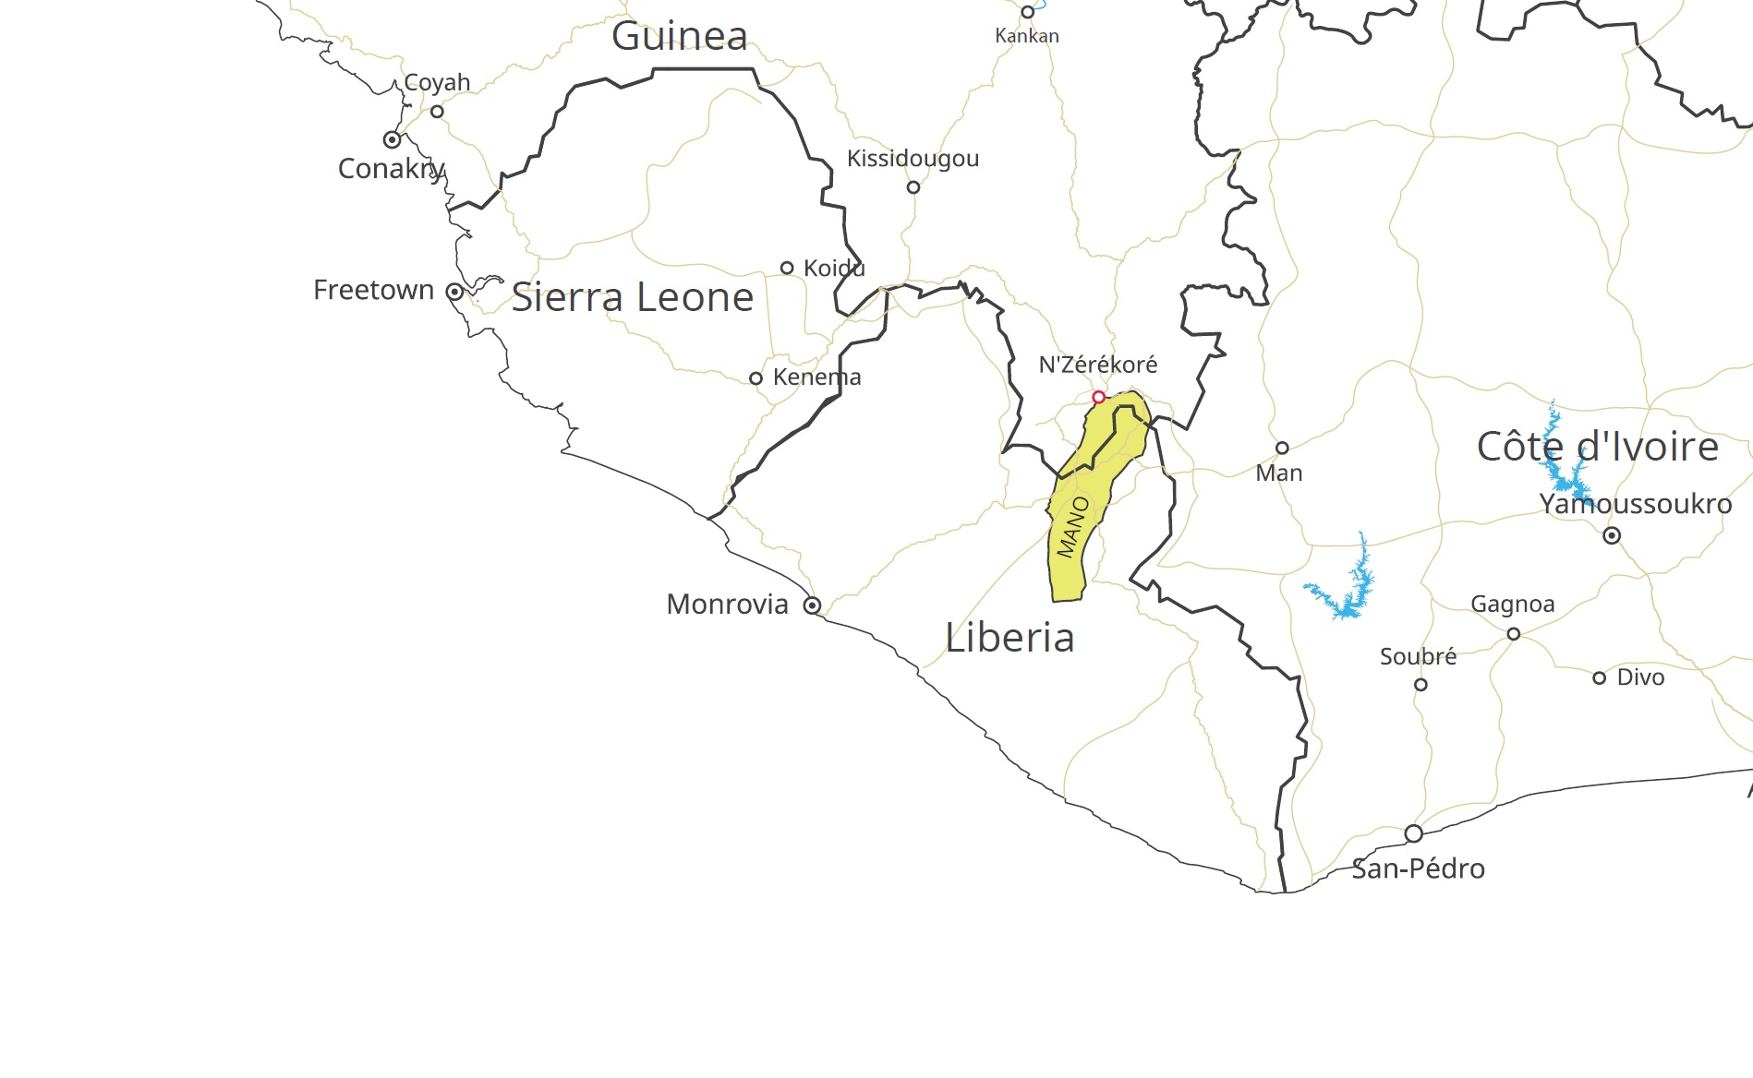

Slide 3
Basic background details
Mano < Southern Mande < Mande < Niger-Congo
~400 000 speakers in Guinea and Liberia
Three tones, rich grammatical tones, especially in verbs
S – AUX – O – V – X
AUX: TAMP + indexing of subject (person and number), pro-drop
“linear” TAMP systems (Welmers 1973: 343): the expression of specific TAMP values is not located in specific markers: it is rather expressed by a construction as a whole which contains auxiliaries together with predicative markers, particles, adverbs and verbs in a particular morphological form
negation is expressed in copulas, in auxiliaries and in additional predicative markers which are used in certain negative constructions

Slide 4
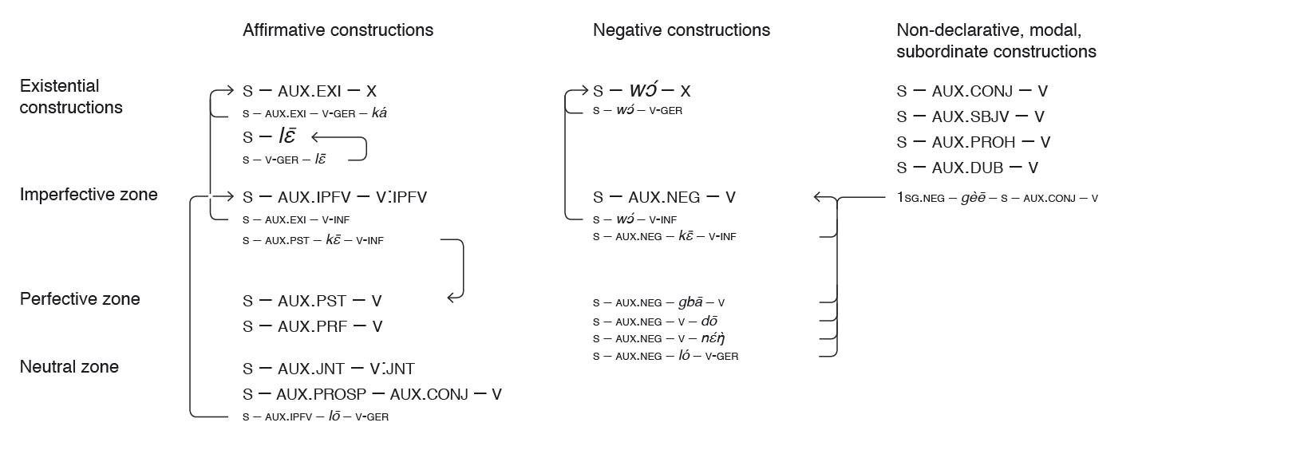
Main TAMP constructions in Mano

Slide 5
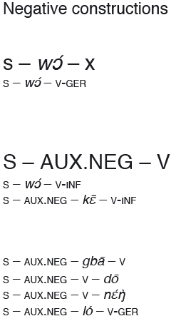

Slide 6
Copulas and auxiliaries
Affirmative copulas: lɛ̄ (general), wɔ́ (presentative, visible/invisible), gɛ̰̀ (presentative, visible)
Negative copula: wɔ́
Series of auxiliaries:
EXI (existential), PST (past), PRF (perfect), IPFV (imperfective), CONJ (conjunctive), NEG (negative), PROH (prohibitive), SUBJ (subjunctive), PROSP (prospective), DUB (dubitative)

Slide 7
Non-verbal predications-1

Slide 8
Non-verbal predications-2

Slide 9
Imperfective

Slide 10
Presentatives
Three affirmative copulas used in affirmative presentative
Semantic incompatibility in negative presentatives

Slide 11
Resultatives
Affirmative resultative: affirmative copula
Negative resultative: negative copula, but different construction

Slide 12
Non-verbal predications + imperfective + resultative: summary
affirmative: existential auxiliary, person and number distinctions; affirmative copulas
negative: negative copula

Slide 13
Negation in declaratives
More aspectual distinctions in affirmative declaratives:

Slide 14
Asymmetry in declaratives

Slide 15
Negation in non-declaratives

Slide 16
Negation in dependent clauses: relative clauses

Slide 17
Bonus interesting features
Dedicated negation marker in irrealis conditional clauses
Split between full and partial negation in indefinite pronouns.

Slide 18
Negative conditionals (irrealis)

Slide 19
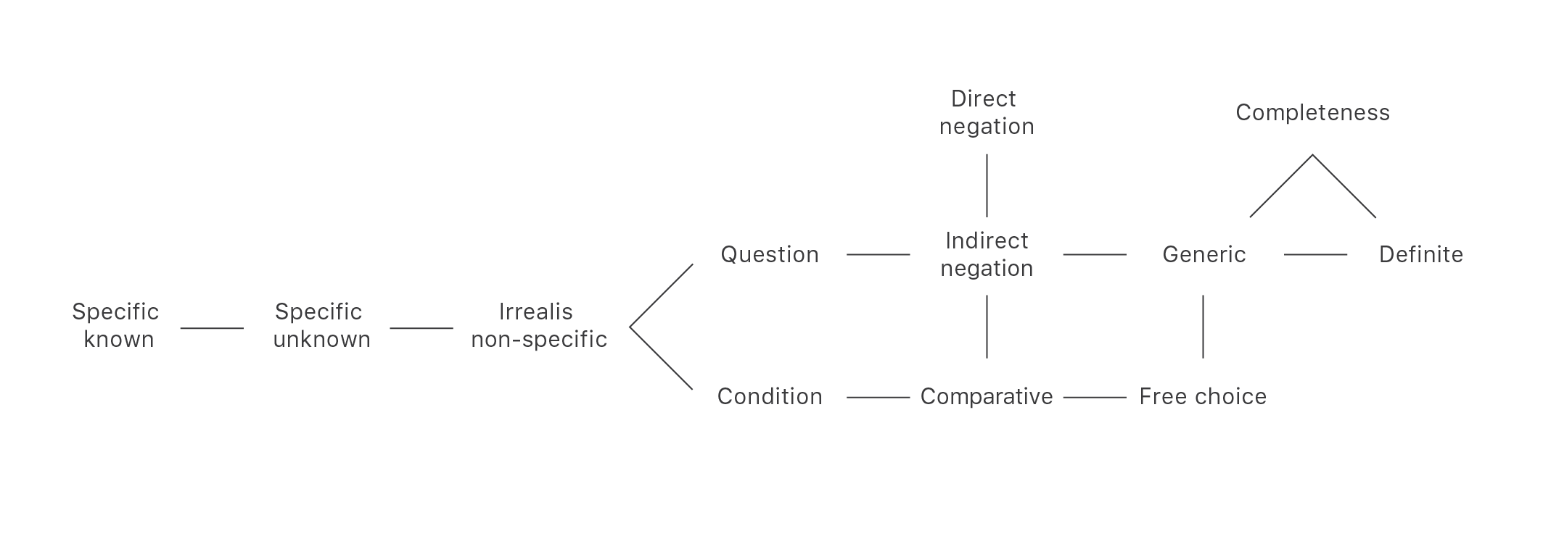
Negation and indefinite pronouns
Semantic map of quantifiers from (Tatevosov 2002)

Slide 20
Indefinite pronouns indirect negation

Slide 21
Indefinite pronouns direct negation

Slide 22
Comparative

Slide 23
Haspelmath 1997, Tatevosov 2002: consider only contexts where negation has a scope over the indefinite marker:
nobody came = there does not exist anyone that came
Similarly, in the «comparative» context:
he works better than anyone = every person is such that he works better than him.
(why this restriction?)

Slide 24
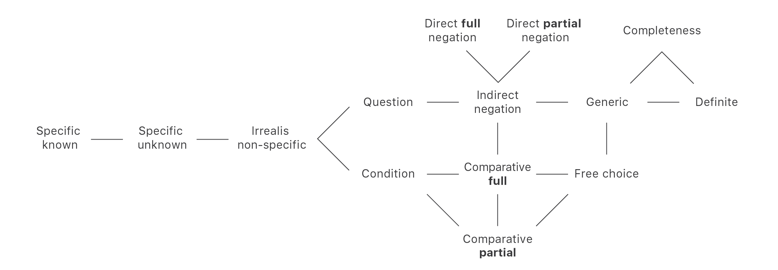
New semantic map of quantifiers
I suggest integrating the values of partial comparative and partial direct negation into the semantic map.

Slide 25
Consider Russian –nibud’, which is also used in contexts with direct partial negation and partial comparative:
Navernoe, kto-nibud’ ne soglasitsa, no rech ne ob etom.
Perhaps, someone will not agree/*no one will agree, but it does not matter.
Navernoe, nikto ne soglasitsa.
Perhaps, no one will agree.
On rabotaet luchshe kogo-nibud’, no ne vseh.
He works better than someone, but not everyone.

Slide 26
At the same time, Russian –nibud’ is used (against the data in Haspelmath) in contexts of
free choice
Vozmi kakoy-nibud’!
Take one (anyone)!
Indirect negation
Ya ne znau, prishol li kto-nibud’.
I do not know whether someone came.

Slide 27
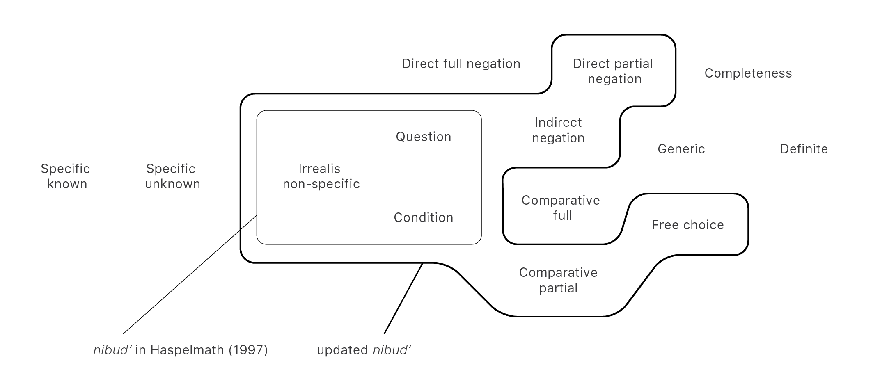
A new semantic map for –nibud’

Slide 28
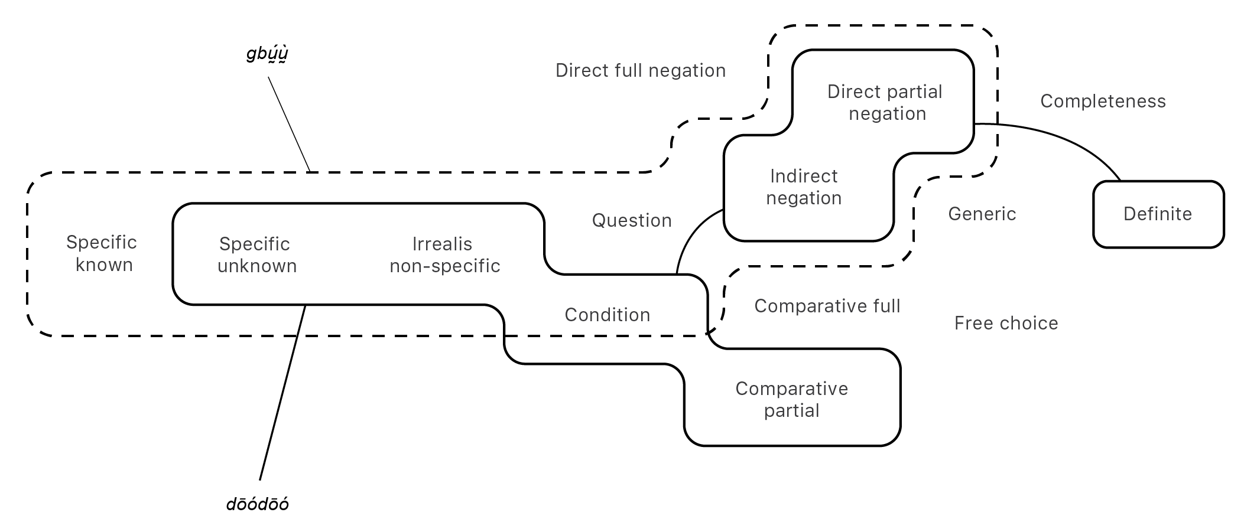
A map for Mano dōódōó and gbṵ́ṵ̀

Slide 29
Summary
Negation in Mano is asymmetric:
  constructional asymmetry: suppletive paradigms of affirmative and negative markers, different structures of affirmative and negative constructions
  paradigmatic asymmetry: the inventory of negative constructions and markers is reduced with respect to the inventory of affirmative constructions and markers
  Different behavior in dependent clauses
A dedicated highly specified negative marker: negative irrealis (used in irrealis conditional clauses)
Distinction between indefinite pronouns used for partial and full direct negation (perhaps, a useful observation for the typology of indefinite pronouns in general)

Slide 30
Thank you!

Slide 31
References
Haspelmath, M. (1997). Indefinite pronouns. Oxford: Oxford University Press.
Miestamo, M. (2005). Standard Negation: The Negation of Declarative Verbal Main Clauses in a Typological Perspective. Walter de Gruyter.
Tatevosov, S. (2002). Semantika sostavlyayushiy imennoy gruppy: kvantornye slova. Moscow: IMLI RAN.
Welmers, W. E. (1973). African language structures. Berkeley: University of California Press.

